Slide 1
Context Aware Computing
From Sensor To Situation Recognition

Slide 2
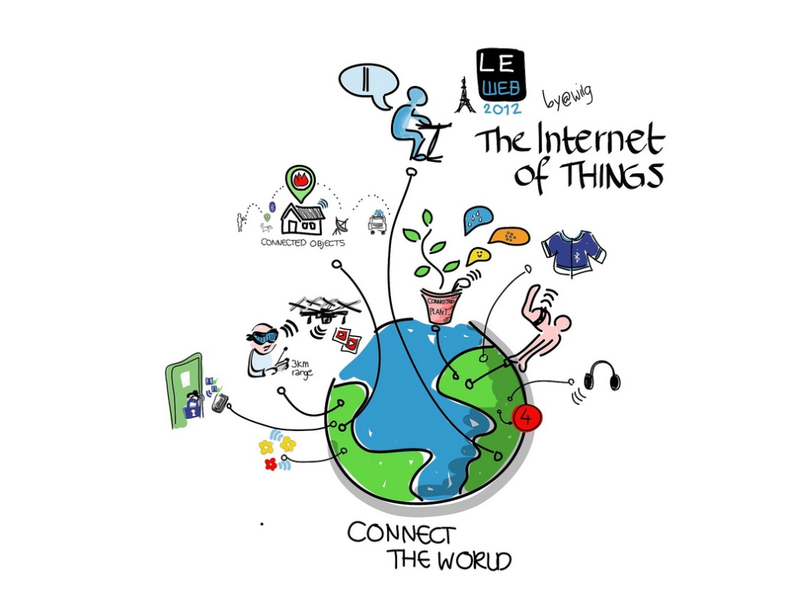
Context Aware Computing
Context-aware computing refers to a general class of mobile systems that can sense their physical environment, and adapt their behavior accordingly
Image courtesy: Wilgengebroed

Slide 3
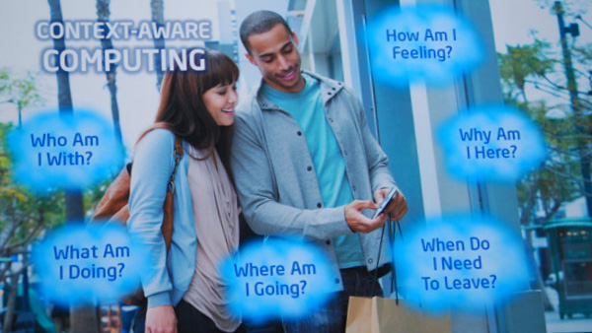
Definition of Context (1/3)
Three important aspects of context are: where you are, who you are with, and what resources are nearby (Schilit)

Slide 4
Definition of Context (2/3)
Schmidt et al.: “knowledge about user’s and IT device’s state, including surroundings, situation, and to a less extent, location”
Dey: “any information that can be used to characterize the situation of an entity”
Entity: person, place, object that is considered relevant to the interaction between a user and an application

Slide 5
Definition of Context (3/3)
Kotz: “the set of environmental states and settings that either determines an application’s behavior or in which an application event occurs and is interesting to the user”
Active context: influences behavior of an application
Passive context: relevant to the application, but not critical

Slide 6
Sensor Data & Context
Sensor Examples | Context Information
GPS, DGPS, RFID, Infrared, QRCode | Location
Camera | Objects Recognition, User Identification
Microphone | Speaker Identity, Environment State
Thermometer, Barometer, Gas Sensor, Fire & Smoke Sensor | Environment Information
Accelerometer, Gyro Meter | Movement Information
Heart-rate, Blood Pressure, Body Temperature | Physiological State

Slide 7
Example : Situation and Contexts
Situation | Context
User sleeps | It is dark, room temperature, silent, type of location is indoors, time is “nighttime”, user is horizontal, specific motion pattern, absolute position is stable
User is watching TV | Light level/color is changing, certain audio level (not silent), room temperature, type of location is indoors, user is mainly stationary
User is cycling | Location type is outdoors, user is sitting, specific motion pattern of legs, absolute position is changing.

Slide 8
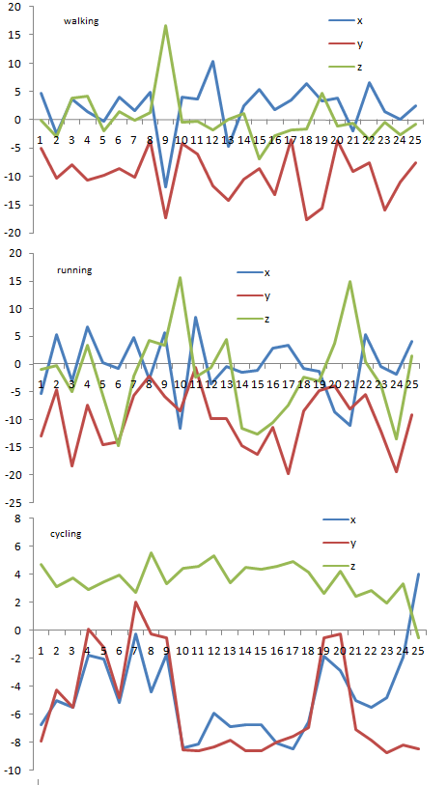
Example : Accelerometer Data

Slide 9
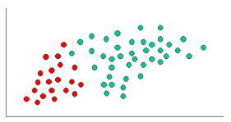

Naïve Bayes → http://www.statsoft.com/textbook/naive-bayes-classifier

Slide 10

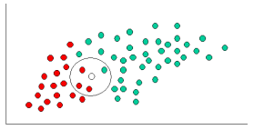
Naïve Bayes Cont
Since there is a total of 60 objects, 40 of which are GREEN and 20 RED, our prior probabilities for class membership are:

Slide 11



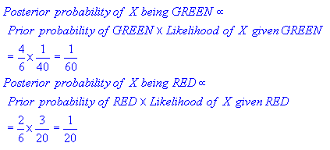
Naïve Bayes Cont.
From the illustration above, it is clear that Likelihood of X given GREEN is smaller than Likelihood of X given RED, since the circle encompasses 1 GREEN object and 3 RED ones. Thus:

Slide 12
Context & Situation

Slide 13
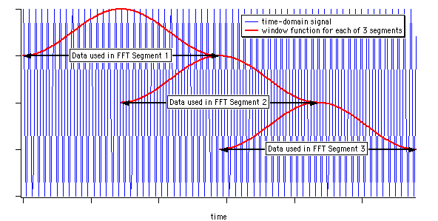
Sensor Data Feature Extraction
Taken within a certain sampling interval
Eg 4,8,15,35,45,50,128 ,256, 512
Sliding window (overlap)
Average
Quartile Distance
Standard deviation.
First derivative.
Max, Min
PCA
Frequency Etc

Slide 14
Principles and Functionality
According to [R2], a context-aware pervasive system can be viewed as having three basic functionalities:
Sensing
Thinking (metaphorically)
Acting
Thinking
Sensing
Acting
[R2] Loke, S. Context-Aware Pervasive Systems: Architectures for a New Breed of Applications. Auerbach Publications, Taylor&Francis Group, Boca Raton; New York. ISBN: 0-8493-7255-0, 2007

Slide 15
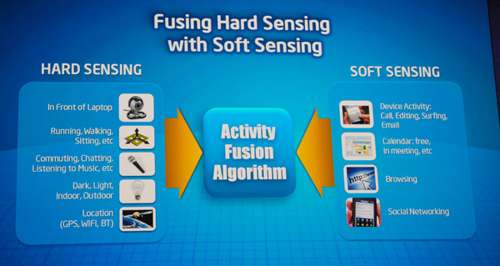
Sensor Fusion

Slide 16
Sensing (Context Acquisition)
Principles and Basic Functionality
Physical sensors
Virtual sensors
Logical sensors
Sensor Fusion
a more comprehensive view
of the physical world
Sensor 1
Sensor 2
Sensor 3
Context values from sensor 1
Context values from sensor 3
Sensor 4
Combination of all the observations i.e. sensor1 + sensor2 + sensors3 + sensor4

Slide 17
Combine Context And Infer Situation
We need sensor fusion technique
Also known as data fusion
Bayesian Network
Dempster-Shafer
Fuzzy Logic
Etc
Need to combine confidence value in relation to the considered situations from various sensor data

Slide 18
Potential Projects
Avalailable Devices
Smart phones, Raspberry, Arduino
Sensors : GPS, Dust, Soil Moisture, Smoke, temperature, humidity, vibration

Slide 19
Tugas
Tugas 1
Dapatkan List Sensor yang ada Di Handphone anda
Dapatkan Data Accelerometer
Deteksi Sensor Cahaya (Untuk Start Program)
Rekam Data Orang Berdiri, Berjalan Dan Duduk
Implementasikan Naïve Bayes atau KNN
Tampilkan pengenalan (Text/ Suara) atau kirim informasi ke Web (plot lokasi dan aktifitas)

